Slide 1
Schoology at GRMS
Schoology is a new communication platform for teachers, students, and parents. We hope this will assist in creating a culture at GRMS that helps our community feel welcome, valued, involved, and informed.

Slide 2
Schoology & Home Access Center (HAC)
Schoology does not replace Home Access in any way. All grades, and attendance will continue to be stored in Home Access. Continue to go there to see your child’s current grades and attendance.

Slide 3
Is there an App for that?
Of course there is!
You should download it now…

Slide 4
Student Access
Go online to: https://stjohnsschools.schoology.com
(or this is on our student symbaloo link page)
Sign in as follows:
First login: login using your
student number as follows: s######@stjohns.k12.fl.us
No PASSWORD (keep the password blank) on the first page
Second login: use your computer credentials as follows: s###### and the password that your homeroom teacher gave you for computer access.
Students have had access to schoology from the beginning of the year. They use the procedures to the right to access schoology. Students use a secure schoology website specific to our district for additional security. This is a DIFFERENT website than parents use to view their student’s schoology page.

Slide 5
Login for Parents!
www.schoology.com
Visit http://www.stjohns.k12.fl.us/media/edtech/schoology-for-parents/ for Schoology support information to help create and use your account.

Slide 6
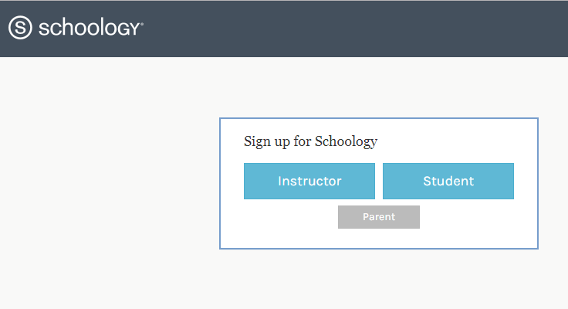
Parent Sign up and Access:
Go online to: https://www.schoology.com/
(Or download the app)
Sign up as a parent (create your own account)
Make sure you use the Parent Access Code on the letter sent home on September 26th with your student.

Slide 7
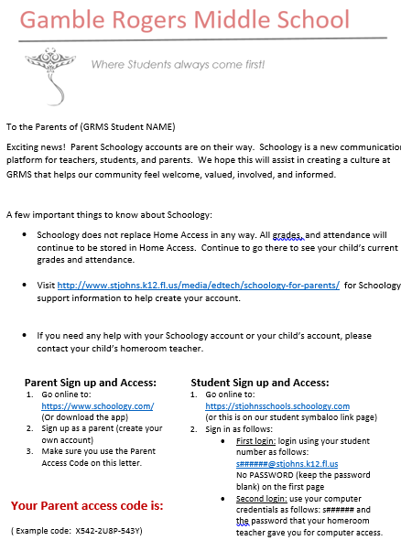
Parent Access Letter
The Parent access code will be in the bottom left corner of the letter sent home with each student.
Each student has a unique code.
Parents can add more than one code for multiple students.
Each code will add all of the students classes.

Slide 8
Information parents will be able to view on Schoology
Assignments & Due Dates (EVENTS)
Syllabus (Materials)
Posts to students & Parents (Updates)

Slide 9
Schoology Quick View
The following slides are examples of how schoology is already in use at GRMS.

Slide 10
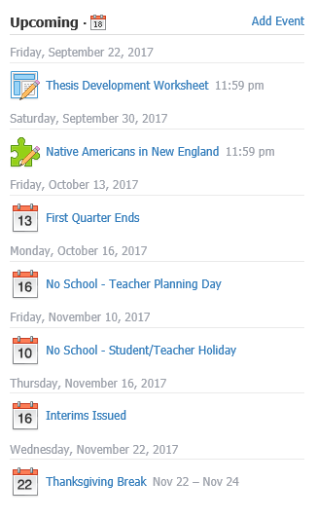
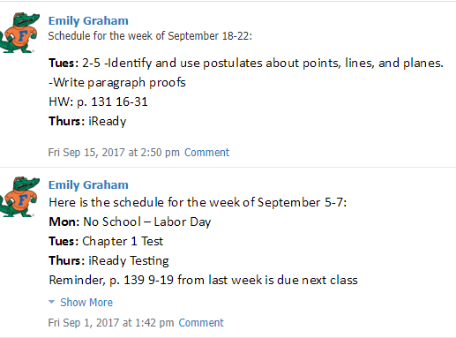
Events – The top right corner of your homepage will look like the picture to the left. This is where most teachers will put their assignments.
Some teachers are posting assignments as Updates like below to allow more details to be seen immediately.

Slide 11
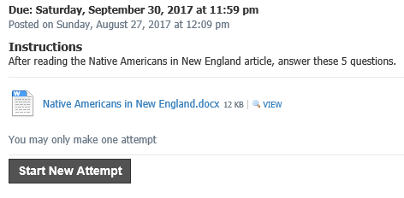
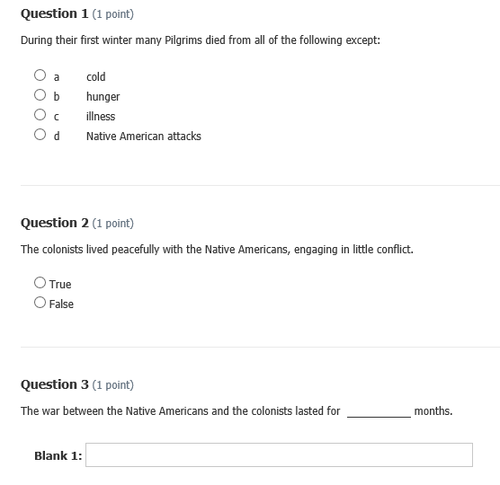
Events can have attachments that include directions and in some cases the assignment itself. This is a great tool if students are absent.

Slide 12
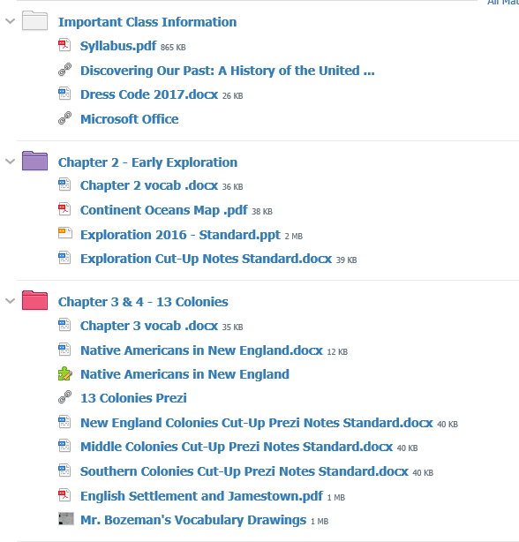
Materials –
Each class has a materials tab in the top right corner.
This is where you can find the class syllabus.
Many of our teachers are also including links and additional uploads in this area.

Slide 13
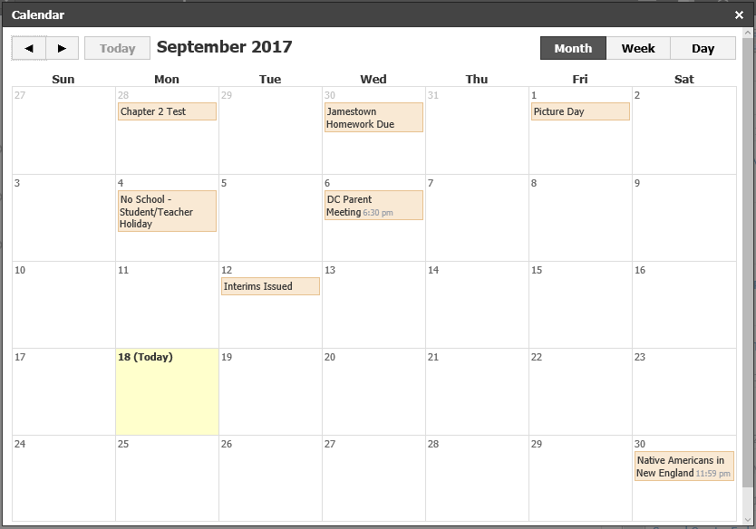
Calendar –
The calendar feature lets you look at all the EVENTS at once.
If you have a teachers using UPDATES to post their homework you will have to look on your homepage or their class page for their homework assignments.

Slide 14
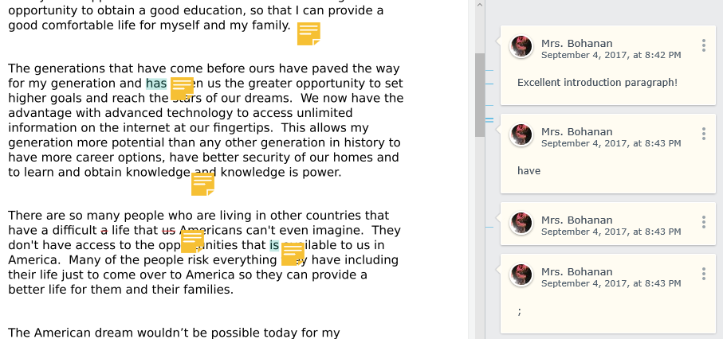
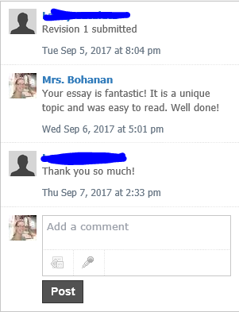
Extras:
Some of our teachers are using schoology for turning in assignments and taking assessments. Schoology allows the teacher to both comment and edit the student’s document.

Slide 15
Extras:
Schoology also allows the teacher to add rubrics to assessments, so students can self-monitor what categories they’re being graded on before they submit an assignment.

Slide 16
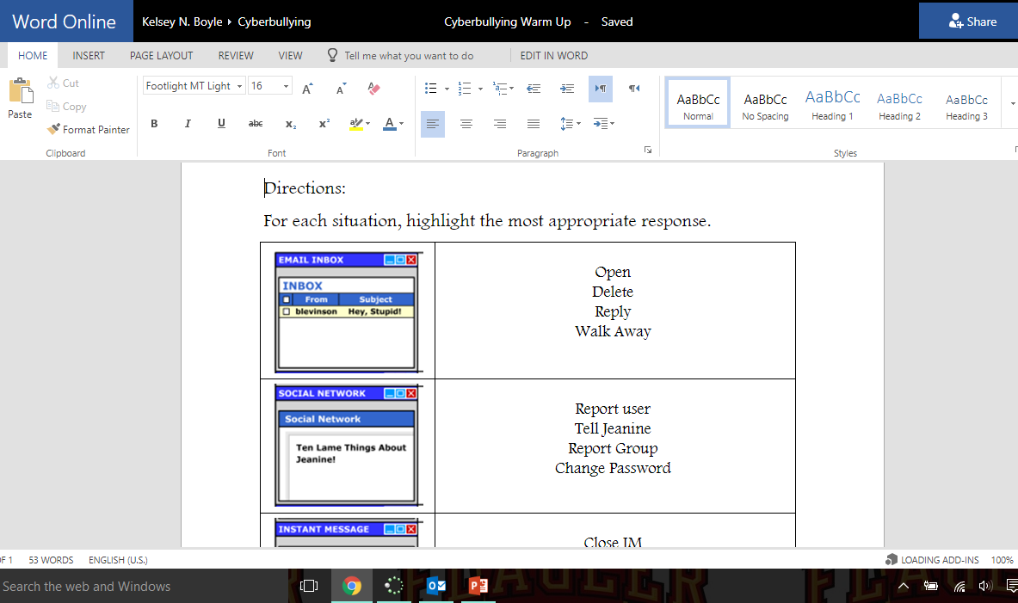
Extras:
Schoology also allows access to Microsoft Online. Student can work on assignments and submit them from home.

Slide 17
Schoology Help
Parent Help Guide
How to Link to Your Child’s Account
How to Setup Your Account Notifications

Slide 18
Frequently Asked Questions
Q: Do parents have to set up their own accounts?
A: Yes, parents/guardians need to register for their own accounts in Schoology. When parents register to create their own accounts in Schoology, part of the registration process is to enter in your child’s access code. Schoology uses this access code to associate your parent account with St. Johns County School’s Schoology portal and to link your new parent account with your child.

Slide 19
Frequently Asked Questions
Q: How do I register for a parent account?
A: Use the following steps to register for your parent account:
In your browser, navigate to www.schoology.com.
In the top right corner of the screen, click the Sign Up button.
Select Parent from the options
Enter the Access Code for your child that was sent home from their school.
Fill out the information for your new Schoology account (your email address and the password you want to use for your Schoology account) and click “Register.”

Slide 20
Frequently Asked Questions
Q: When going through the registration process, do I enter in my child’s name in the box?
A: No, when registering for your parent Schoology account, you enter in your information in the box, not your child’s. Your child already has a Schoology account.
Q: Do I need to set up an account for my child?
A: No. All active SJCSD students automatically have a Schoology account. They can log in at https://stjohnsschools.schoology.com using their school account and password.

Slide 21
Frequently Asked Questions
Q: How do I get my child’s access code?
A: Parent letters with your child’s access code will be sent home from each school. If you did not receive a letter or have lost the code, please contact your child’s teacher.
Q: Do I create a parent account for each of my children?
A: No, if you have multiple children, you create a single parent account with 1 child’s code. After you have created your account, you can link the rest of your children to your account within Schoology by clicking on the arrow in the top left corner by your name and selecting +Add Child. Enter in another child’s code in the box, click “USE CODE” and they will now be linked to your account. You can link each child in your family to your account in this manner.

