Slide 1
Gamble Rogers Middle School
It’s a great day to be a stingray!

Slide 2
Principal: Brian Wilson
Assistant Principals:
Daryl Cullipher
Daryl.cullipher@stjohns.k12.fl.us
Lydia Yeoman
Lydia.yeoman@stjohns.k12.fl.us
Brian.wilson@stjohns.k12.fl.us
U.S. 1 South
St Augustine, FL 32086
https://www-grms.stjohns.k12.fl.us/
GRMS: (904) 547-8700

Slide 3
More Introductions
Please contact Guidance for Parent Conference Requests
Dean
Guidance
Tony Canoura
Grades 6-8
Student Last Name A – L
Tony.Canoura@stjohns.k12.fl.us
Patrick Halloran
Patrick.halloran@stjohns.k12.fl.us
Danielle Waldrop
Danielle.waldrop@stjohns.k12.fl.us
Guidance
ILC – Instructional Literacy Coach
Amy Kelly
Grades 6-8
Student Last Name M – Z
Amy.Kelly@stjohns.k12.fl.us
Allison Romano
Allison.romano@stjohns.k12.fl.us

Slide 4
Within this Presentation
Schedule
Opportunities
Your students will go to seven periods per day.
Wednesday is an early release day (12:50)
We hope your student loves being a stingray. Our goal is for every student to feel safe and welcome at GRMS while encouraging them to grow and become involved.
Policies
Who we are
Everything you want to know about dress code, check out, messages, and phones.
Gamble Rogers Middle School prides ourselves on being an AVID and PLC school with an emphasis on building student leaders through collaboration.

Slide 5
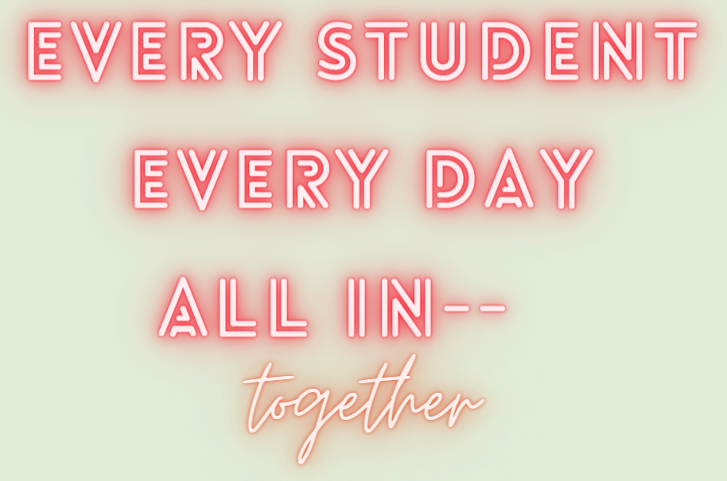
—Click Here to view GRMS Teachers
GRMS Teachers

Slide 6
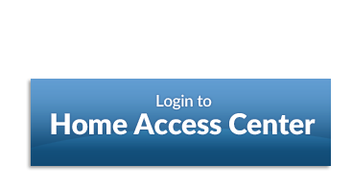
GRMS Communication
GRMS: (904) 547-8700
Schoology
Home Access Center - HAC
Email
Student & Parent Access
Students use their school S# and password to access HAC.
Parents can create a new account through the SJCSD website.
Please contact Lisa Greve for assistance.
Lisa.greve@stjohns.k12.fl.us
GRMS Weekly email
Mr. Wilson sends out a weekly email to all parents every week.
If you are not receiving this email please check your email address listed in HAC.
Student & Parent Access
Students use schoology for class assignments, information, & calendar.
Schoology is a great place to find assignments when you are absent!
Click here for more information on Schoology
Click here to access HAC

Slide 7
Start time!
Students enter the building @ 7:10
Students are released to class @ 7:20
Class Begins @ 7:33
*The parent drop off and pick up line can back up.

Slide 8
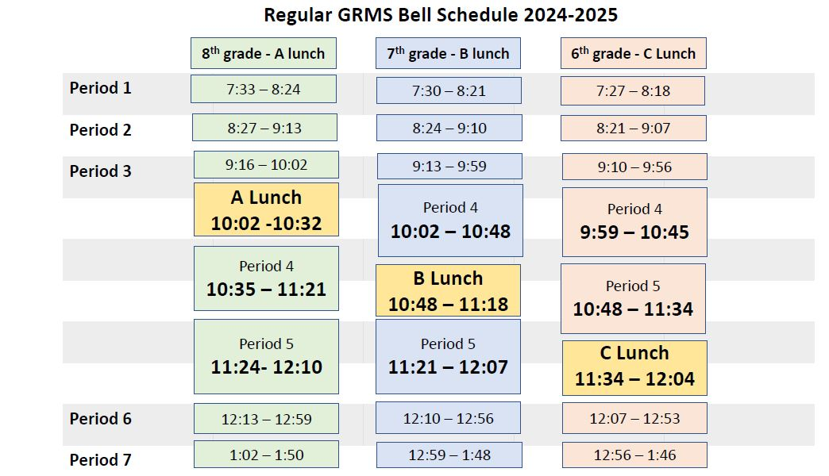
… Normal Schedule! (except Wednesday)
Students are in class at 7:33
Lunches are by Teacher
Students are released at 1:50

Slide 9
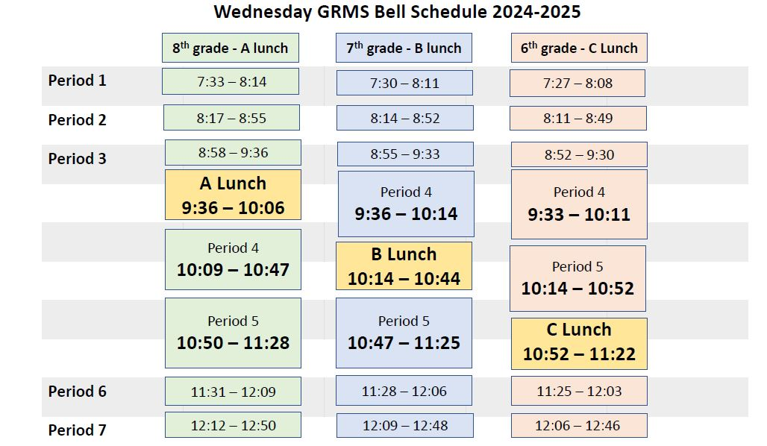
… Wednesday Early Release Schedule
Students are in class at 7:30
Lunch timing changes but is within the same period.
Students are released at 12:50

Slide 10
How can we assist you?
Drop Off
Message Board
· Call the office and speak with Mrs. Willis, who will write the message down
· Your student’s name will be placed on the student message board in the main hall (Encourage your student to check the board daily)
· Students whose name appears on the message board will bring the name slip to Mrs. Willis and she will give the message to the student.
· If a student’s name is still on the message board during the last period of the day, a WEB student will deliver the message to the student’s classroom.
Please let us know if your child has forgotten their lunch. We will hold it in the front office until they receive the message from the message board.
*Note food from outside sources are not permitted.
Check Out
Students must be checked out prior to 30 minutes before the end of the day.
Last check out on a regular day is 1:20 PM
Last check out on Wednesday is 12:20

Slide 11
Student Essentials
Planner
School ID
Locks for Lockers
Provided by GRMS
After pictures are taken
Used to check out library and textbooks
Students should have their ID’s with them daily
Optional: Not Provided
Students who wish to use a locker in their homeroom will need to provide their own combination lock.
Homeroom teachers record student lockers and locker combination
Provided by GRMS
Used for organizational skills
Teachers post agendas for students to write in their planners
Used to leave the classroom

Slide 12
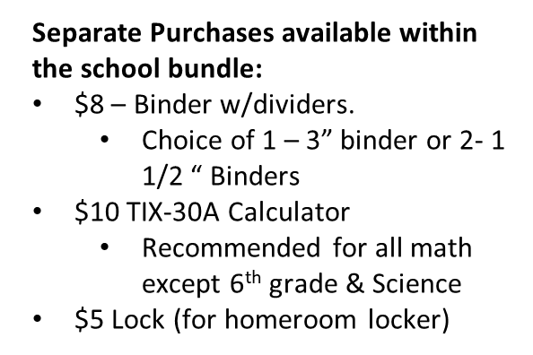
♦ 24-25 GRMS School Supply List
♦ 2024-2025 Elective Supply List
School Supplies
2024 - 2025

Slide 13
PBiS Stingray Fever
Stingray Standouts: students of the week
Green Tickets:
F-Focus on the Positive (GRMS Stingrays focus on promoting a positive mindset through CARING and FAIRNESS).
E-Encourage Engagement (GRMS Stingrays are RESPONSIBLE and engaged in class each day).
V-Value All (GRMS Stingrays RESPECT everyone in our school family and treat others with FAIRNESS).
E-Elevate Your Character (Stingrays demonstrate good CITIZENSHIP in the way they deal with others).
R-Ready to Achieve (Stingrays are ready to achieve when they exemplify all pillars of CHARACTER COUNTS).
New: stingray success reward

Slide 14
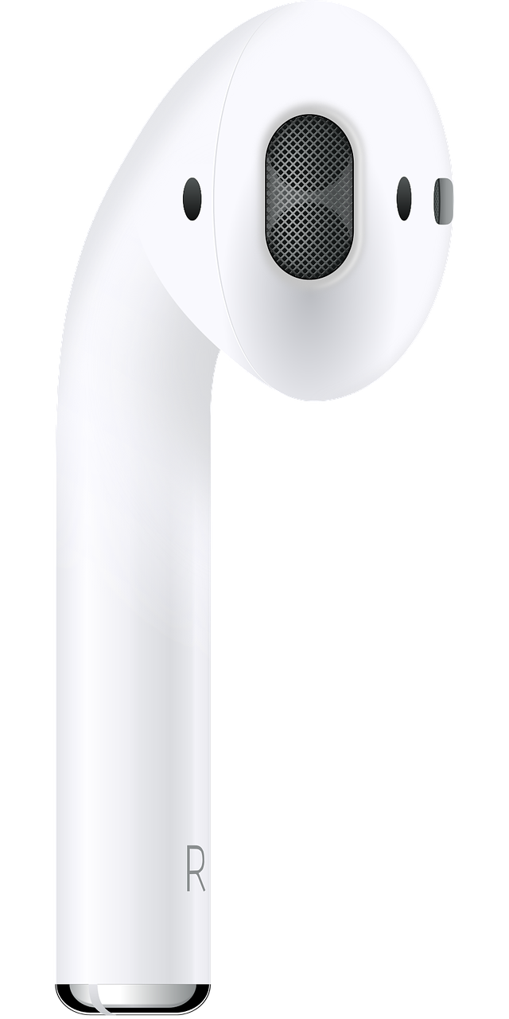
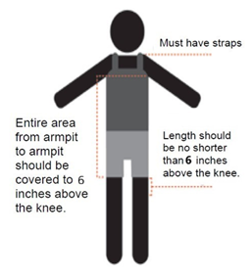
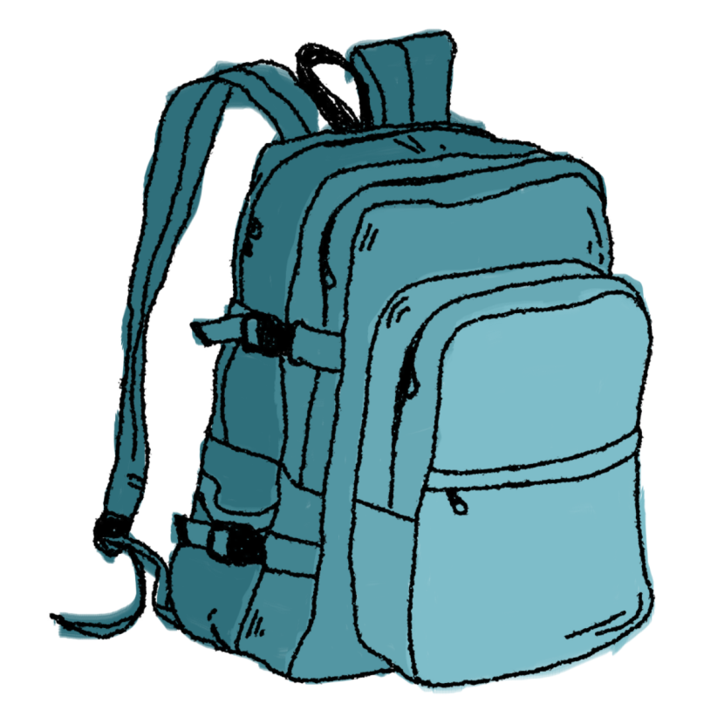
Dress Code
Cell Phones
Expectation: Student clothing choices are both respectful of the school community and are appropriate for an educational environment.
Expectation: Upon entering the campus cell phones and electronics (earbuds, AirPods, headphones) will be turned off and stored in the student’s backpack. Earbuds will be removed to assist students in maintaining academic focus.
Clothing must cover areas from one armpit to the other armpit, down to 6 inches in length above the top of the knee. Tops must have shoulder straps.
Shoes must be worn at all times and should be safe for travel around campus.
Recording other students and teachers is strictly prohibited
No clothing advertising alcohol, drugs, weapons, nudity, profanity, etc.
Click here to access the SJCSD Code of Conduct
Notes:
Reasons why dress code matters: we want your focus on learning in the classroom without distractions. We also want you to dress for success and represent the best you possible!

Slide 15
Clubs and Sports
GRMS Sports
Try Outs for:
Volleyball
Basketball
Open to ALL!
Cross Country
Track
Clubs
Art Club – Ms. Demaio
Best Buddies – Ms. Dufrain
Chess Club – Ms. Kinnaman
National Honors Society – Ms. Bohanan & Ms. Register
Robotics Club – Mr. Thornton
SJMAA Sports
Football
Cheerleading
Soccer
Tennis
Softball
Baseball
Golf

Slide 17
PLC Professional Learning Community
PLCs Make Us All Better!
Teachers plan together and discuss Big Ideas within their state standards.
Teacher’s create common summative and formative assessments.
Students benefit from the expertise and knowledge from within the PLC
Data is discussed within PLCs to customize instruction based on results.
PLC is part of our school culture.
We collaborate to provide the best education possible for our students.

Slide 18
Advancement Via Individual Determination
Every student at GRMS is an AVID student
AVID also helps both students and teachers implement (WICOR) Writing, Inquiry, Collaboration, Organization, and Reading strategies in the classroom.
Students in all classes will use WICOR strategies and AVID structures.
The AVID elective course is a college & career preparatory class for 6-8 grades.
Please reach out to the AVID teacher Ms. Alexander at any time with questions or student concerns!

Slide 19
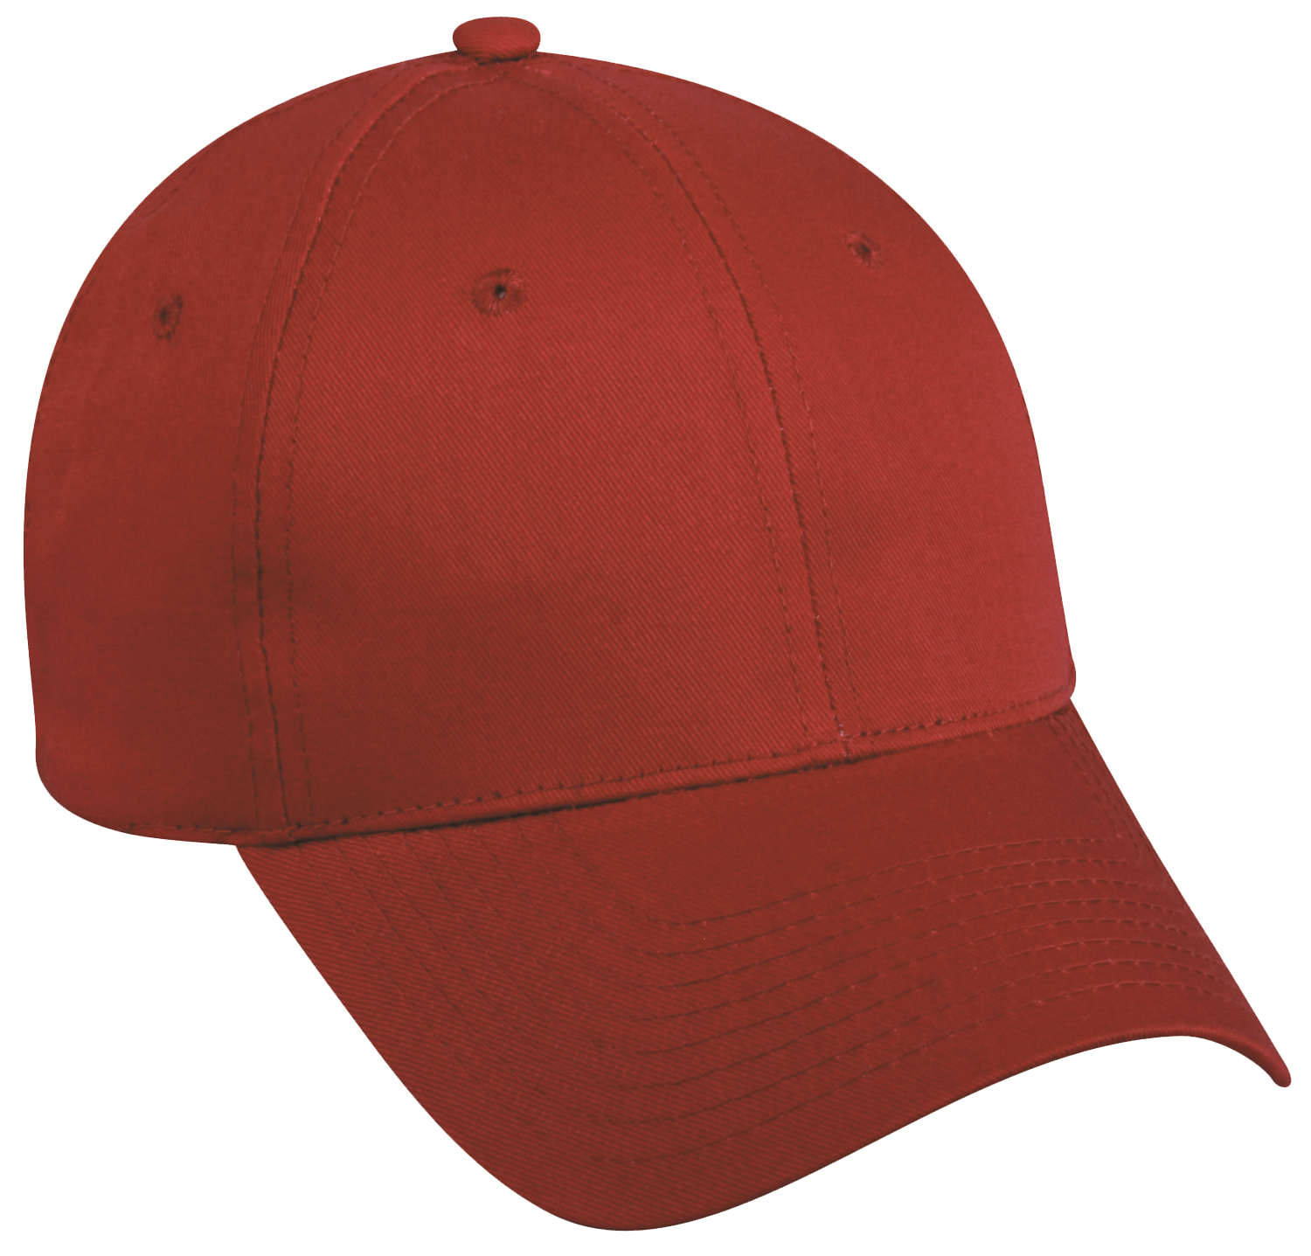
WEB Leaders
WEB Leaders / Peer Counseling class is a selected group of 8th graders who are positive role models and want to make a difference at school and in the community. These students appear to be wearing 2 hats – Mentoring and Mediation.
Mentors are developing relationships with 6th graders all year on how to be successful in middle school using words of wisdom.
Mediators are trained in 6 step process to help people work out their differences in a private session and writing an agreement to help keep peace in the future. They collaborate to help make GRMS a positive safe fun place.
WEB Leaders are available help with projects, labs, and other activities that require extra support in classroom.
Mentor
Mediator

Slide 20
Interested in Volunteering with us?
Click here to apply for school access (required to come on campus with students!)
Click here if you are interested in being a GRMS Business Partner

Slide 21
PTO
The Gamble Rogers PTO supports students, staff, and teachers at GRMS, but we're only as strong as our membership. And membership means different things for different people: some like to volunteer during the day, some like to send in supplies, and others support fundraising. We all have a role to play, and we hope you'll find yours with us! You can receive updates in a variety of ways.
♦ Check out our PTO website - https://www-grms.stjohns.k12.fl.us/pto/
♦ Email GRMS PTO @ Gamblerogerspto@gmail.com
♦ Click here to join our GRMS PTO Facebook group for frequent updates
Join PTO, Purchase Spirit Wear and/or Make a Donation Use the link below https://schoolpay.com/parent/mip/MdVsu Spirit wear will only be available for purchase online and will be delivered to students in homeroom.
♦ Pay by credit card, cash or check (make checks payable to GRMS PTO) ♦ Orders will be delivered to the student's homeroom
Volunteer
Donate
Support

Slide 22
SAC
2024 - 2025
Welcome to GRMS SAC Committee! Parents and members of our community is encouraged to join our School Advisory Council. It's a great way to hear about school happenings and build relationships with our parent and community partners.
For more information about GRMS School Advisory Council, please contact the SAC Chairperson, Ms. Racano at Jaclyn.racano@stjohns.k12.fl.us or 904-547-8700.

Slide 23
It’s a great day to be a stingray!
Every Student. Every Day.
All In! Together!

